Slide 1
Pipelining
Dr. John Abraham
Professor
UTRGV

Slide 2
RISC - CISC
RISC - reduced instruction set computers. The idea is that a simpler approach to an architecture will be faster than a complex architecture. Back to basics movement (started in the 1980s) to create simpler ISAs
RISC computers have most of these properties
Instructions are conceptually simple and uniform length
Instructions have 1 or few formats, 1 or few addressing modes, and the ISA is orthogonal (few or no overlaps)
load-and-store architecture
ISA supports 2 (or few) datatypes (int and float pt)
In favor of CISC:
richer instruction sets improve merit of the architecture and do not increase the cost
upward compatibility will usually result in longer and more complicated instructions
richer instruction sets simplify compiler design
complex instructions make cloning an architecture more difficult (which means that the architecture will be more proprietary)

Slide 3
More comparison
Changes in technology (such as IC memory over magnetic core, and the availability of cache) has made CISC less advantageous
Compilers often do not take advantage of many of the complex instructions, opting instead for simpler instructions
Most often used addressing modes are the simplest ones
Load-and-store ISAs need a lot of registers to be efficient but registers are much cheaper today than in the past

Slide 4
ISA Complexity and Pipelining
CISC does not allow for easy pipelining:
if operands in memory, then pipelining times are not the same due to operand fetch
conditional branching might test some flag(s) and therefore have to wait for other executing instructions which might set or clear flags
In RISC, an effort is made to develop an ISA that can take advantage of pipelining and not cause problems as mentioned above

Slide 5
Pipelining defined
Multiple instructions are overlapped in execution
Divide the work of the cpu as equally as possible.
MIPS lends itself to pipelining because the only operations that affect memory are load and store and the instruction size is the same.
Clues taken from automobile assembly line. Person posted in each stage, must complete the work as the next one comes in. So each stage should take approximately same amount of time.

Slide 6
Terminology
Pipe Stage - also a pipe segment, each step in a pipeline
Throughput - how often an instruction exits the pipeline
Machine cycle - time to move through 1 pipe stage
Stall - a situation in which a pipe stage requires more than 1 machine cycle to complete
this freezes the pipe until that stage is done
Time per instruction on a pipelined computer:
TPI = TPI unpipelined / number of pipe stages

Slide 7
MIPS
32 registers
3 classes of instructions:
ALU instructions
Load and store instructions
Branches and jumps
Implementation of one instruction takes 5 clock cycles
Instruction Fetch (IF)
Instruction Decode (ID)
Instruction Execute (EX)
Memory Access (MEM) in case of load/store
Write-back (WB)

Slide 8
5 stages
IF – send the Program Counter to memory and fetch the current instruction. Update the PC by 4 bytes (why?).
ID – instruction decode and register fetch. Decode the instruction and read the operand registers from the register file. Compute branch target address by adding the offset to incremented PC, this is for branching.
EX – Memory reference operation for data in RAM. Register-Register Operation for data in Register. Register Immediate. One register and immediate
MEM. Calculate effective address and read. If write send it to effective address.
WB. Write the results into register file.

Slide 9
MIPS Pipeline Datapath
State registers between each pipeline stage to isolate them
IF:IFetch
ID:Dec
EX:Execute
MEM:
MemAccess
WB:
WriteBack
Add
4
Shift
left 2
Add
Instruction
Memory
Read Addr 1
Data
Memory
Register
File
Read
Data 1
IFetch/Dec
Read Addr 2
PC
Read
Address
Read
Data
Write Addr
Dec/Exec
Exec/Mem
Address
Read
Data 2
ALU
Mem/WB
Write Data
Write Data
Sign
Extend
16
32
System Clock
Notes:
Note two exceptions to right-to-left flow
WB that writes the result back into the register file in the middle of the datapath
Selection of the next value of the PC, one input comes from the calculated branch address from the MEM stage
Only later instructions in the pipeline can be influenced by these two REVERSE data movements.
The first one (WB to ID) leads to data hazards.
The second one (MEM to IF) leads to control hazards.
All instructions must update some state in the processor – the register file, the memory, or the PC – so separate pipeline registers are redundant to the state that is updated (not needed).
PC can be thought of as a pipeline register: the one that feeds the IF stage of the pipeline. Unlike all of the other pipeline registers, the PC is part of the visible architecture state – its content must be saved when an exception occurs (the contents of the other pipe registers are discarded).

Slide 10
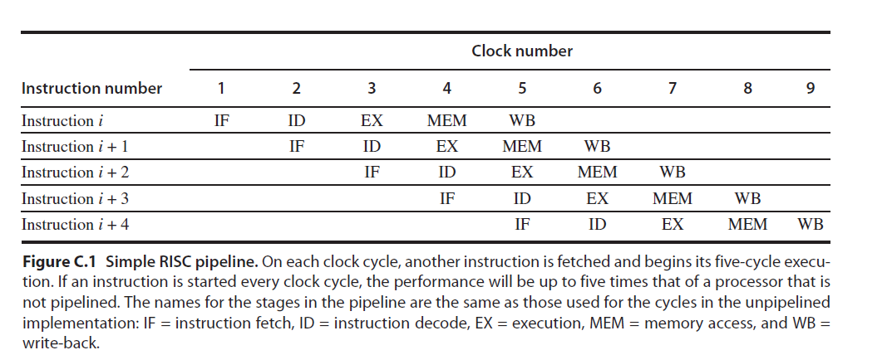
Five-Stage Pipeline for MIPS

Slide 11
Speed up realized
If all stages are balanced time for each instruction can be reduced by time it takes without pipelining divided by the number of stages. Pipeline rate is limited by the slowest stage.
Initial filling up and final emptying of pipeline will have to be added to the time. In a long program it would not matter much.
It follows, more the pipeline stages, the more speed up

Slide 12
